Slide 1

Elect Your Leader
Instructor: Dr. Lee Group members: 1. Jyothi Kiran
2. Gopi Krishna
3. Sidrah
4. Mohannad
Notes:
We designed this template so that each member of the project team has a set of slides with its own theme. Members, here’s how you add a new slide to just your set:
Mark where you want to add the slide: Select an existing one in the Thumbnails pane, click the New Slide button, then choose a layout. The new slide gets the same theme as the other slides in your set.
Careful! Don’t annoy your fellow presenters by accidentally changing their themes. That can happen if you choose a different theme from the Design tab, which changes all of the slides in the presentation to that look.

Slide 2
Portal for choosing a leader………
Businesses, governments, communities, and organizations in general need leaders.
Traditional Voting System:
Dates will be declared
The candidates will file the nomination papers.
They will do campaigning
People has to travel to their localities and has to wait for hours to cast their vote.
Sometimes, re-polling happens if initial polling is unsuccessful due to reasons such a adverse weather, violence etc.,
It is a tiresome, uneconomical, inefficient process.
Our voting system will be an solution for all these complications.

Slide 3
Online voting system
Objective
Implementation
Should be available to everyone :
Should be cost free, both from maintaining side and people’s side
Saving all resources.
Election fraud
We designed a web based application, so any one can access with an internet and media devices.
Maintenance side, checking it time to time for servers problems and from people side all they had to do is open browser and type this URL from their homes.
Manpower, security system all can be avoided.
Our application will avoid bad vote.

Slide 4
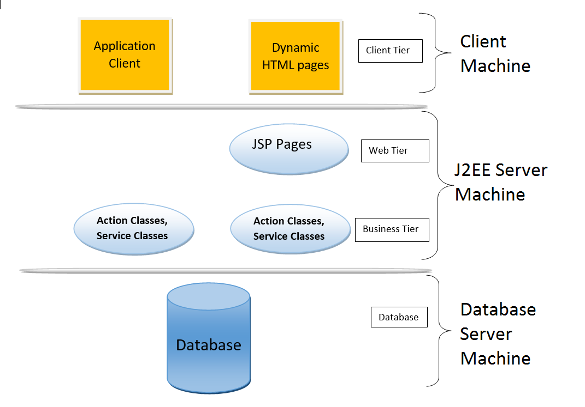
System Architecture

Slide 5
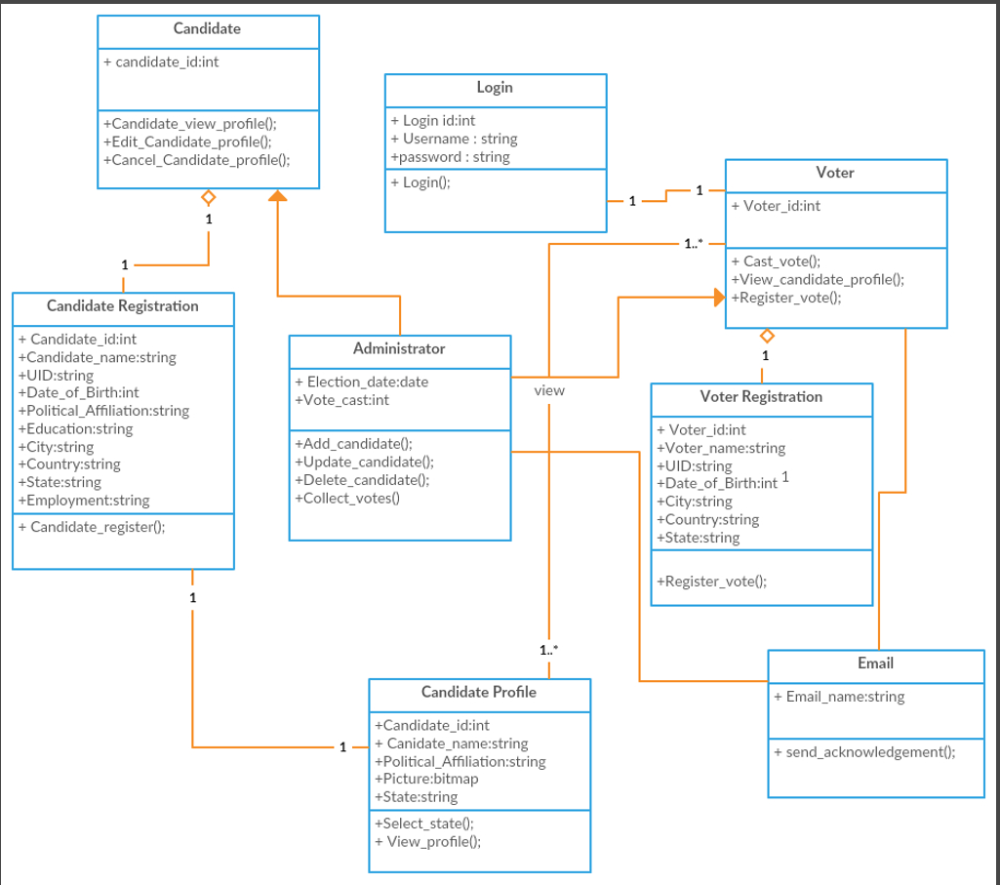
UML Diagram

Slide 6
Features of our application:
Voter and candidate registration
Voter Unique ID & Password are encrypted and stored in database for security.
Voter can view contesting candidates in his locality.
Voter can customize his image and his details in his profile.
Voter & candidate can see the information about all the votes casted to a person.
Voter can share this application with his friends and family with Facebook share, twitter and google+
Voter or candidate can create an event of the election date in the calendar and can notified on the election date.
Voter or candidate can contact the administrator team for any support.

Slide 7
Challenges faced:
Choosing the right approach.
Integrating drivers with the eclipse frame work.
Not much resources available online.
Working on the feedbacks.
Maintaining the quality of the code.

Slide 8
Conclusion:
Our voting application can be a solution for scalable, economical and fraud free voting system. The voting system will be transparent and can be accessible from all locations.
Our system can nullify the resources being spent for the voting.
It is very effective for choosing a leader as the voter will know about the candidate that he is going to vote.

Slide 9
References:
http://www.codejava.net/
http://www.w3schools.com/
http://www.tutorialrepublic.com/
https://struts.apache.org/docs/home.html

